Slide 1
Representation: Media as text

Slide 2
What is Representation?
In media studies, representation is the way aspects of society, such as gender, age or ethnicity, are presented to audiences.

Slide 3
Representation is how media texts deal with and present gender, age, ethnicity, national and regional identity, social issues and events to an audience.
Media texts have the power to shape an audience’s knowledge and understanding about these important topics.
This makes them very powerful in terms of influencing ideas and attitudes.

Slide 4
In order to analyse media texts to determine how they've represented ideas and issues, it's important to be familiar with some of the key terms.

Slide 5
Key terms in Representation:
Construction
This is the way a media text is put together. In a film or television programme this includes the editing and choice of camera angles, in a magazine or newspaper it includes the layout and writing as well as the choice of images.

Slide 6
Mediation
This is the process everything goes through before it reaches an audience.
This can be how a film script is written and re-written before it makes it to production, how newspaper or magazine photographs are cropped and captioned, or how real life events - like a protest or a speech by a politician - are portrayed in a news report.

Slide 7
Selection
This refers to what has been selected to include in a media text.
This can be particularly important in newspaper articles, where selecting certain facts over others can change the angle of a story; what is omitted is sometimes as important as what is included.

Slide 8
Anchorage
These are the words that go along with images to give those pictures a certain meaning in a specific context. This includes captions and headlines in newspapers and taglines in adverts or on film posters.

Slide 9
Stereotypes
These are a simplified representation of a person, groups of people or a place, through basic or obvious characteristics - which are often exaggerated.
For example, Vicky Pollard from Little Britain is a stereotypical example of a working class teenage girl.
They can be used to describe characters quickly, relying on existing audience recognition.
Stereotypes are dangerous as they can lead audiences to generalise about people or places.

Slide 10
Ideology
These are ideas and beliefs, held by media producers, which are often represented in their media texts.
In a newspaper, the ideology of the owner or senior editors could influence the way certain stories are represented, such as lending support to a particular political party.
In a documentary about asylum seekers, the representation of their story could be influenced by the ideology of the filmmaker or producer.

Slide 11
How are representations constructed?
Camera shots and angles
A low angle camera shot can make someone seem more powerful and in control than they really are.
A high angle shot of the same person may make them seem less important or influential.
Editing
Media producers can manipulate the emotions of the audience by representing certain characters or situations through editing.
For a documentary style reality show, like Don't Tell the Bride, many hours of film footage may have been recorded, but this footage is edited down to fill a one hour broadcast.
How it is edited will determine how the characters are represented and how the audience respond to them.

Slide 12
Audio codes
The representation of a person or fictional character can be influenced through their dialogue; if they use slang or speak with a strong accent, audiences will respond to that person in a very different way than someone who speaks perfect English without the trace of an accent.
Music can also influence representation in a media text. In a film scene, where a character is walking down a street, a slow, sombre piece of music will create a very different representation to a cheerful, upbeat tune.

Slide 13
Representation in print
In print based media texts representation is constructed using:
Layout and Design
Language and Mode of Address
Camera shots and angles in any photographs
Visual codes
Anchorage

Slide 15
https://www.bbc.co.uk/bitesize/guides/z9fx39q/revision/1

Slide 16
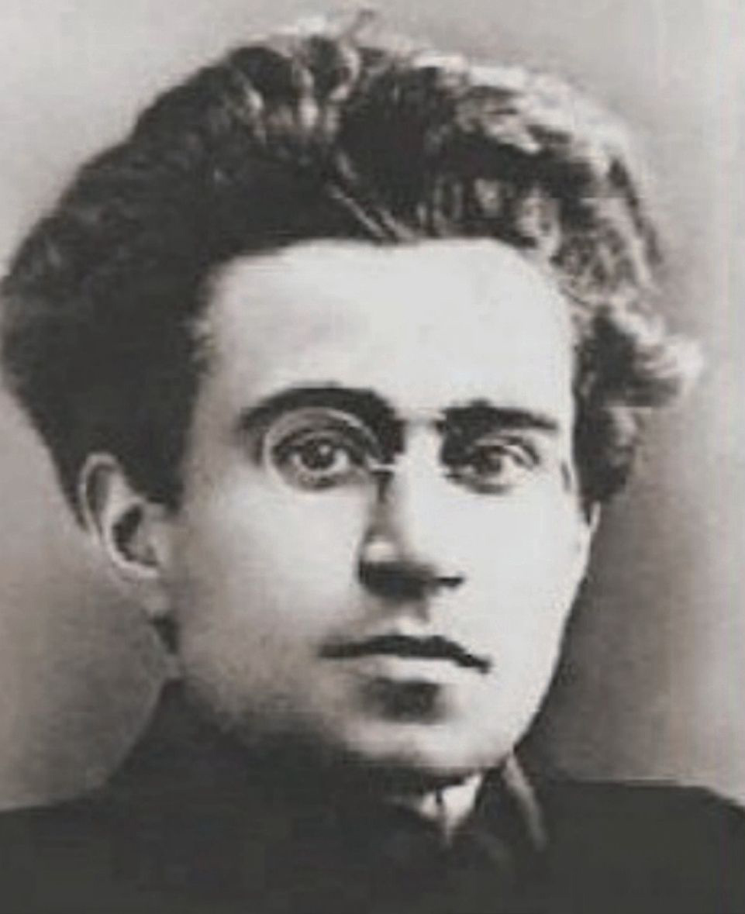
Cultural hegemony
Antonio Gramsci

Slide 17
Cultural hegemony is a term developed by Antonio Gramsci, activist, theorist, and founder of the Italian Communist party.
Writing while imprisoned in a Fascist jail, Gramsci was concerned with
how power works:
how it is wielded by those in power and
how it is won by those who want to change the system.

Slide 18
The dominant idea at the time amongst Marxist radicals like himself was that in order to attain power you needed to seize the means of production and administration — that is, take over the factories and the state. But Gramsci recognized that this was not sufficient. In his youth, he had witnessed workers take over factories in Turin, only to hand them back within weeks because they were unsure what to do with the factories, or themselves. Gramsci had also observed the skill of the Catholic Church in exercising its power and retaining the population’s allegiance. Gramsci realized that in order to create and maintain a new society, you also needed to create and maintain a new consciousness.

Slide 19
https://beautifultrouble.org/theory/cultural-hegemony/

